Slide 1



IRC BUSINESS MEETING
BERLIN
7 AUGUST 2012
SEMINARIS CAMPUSHOTEL  DAHLEM

Slide 2
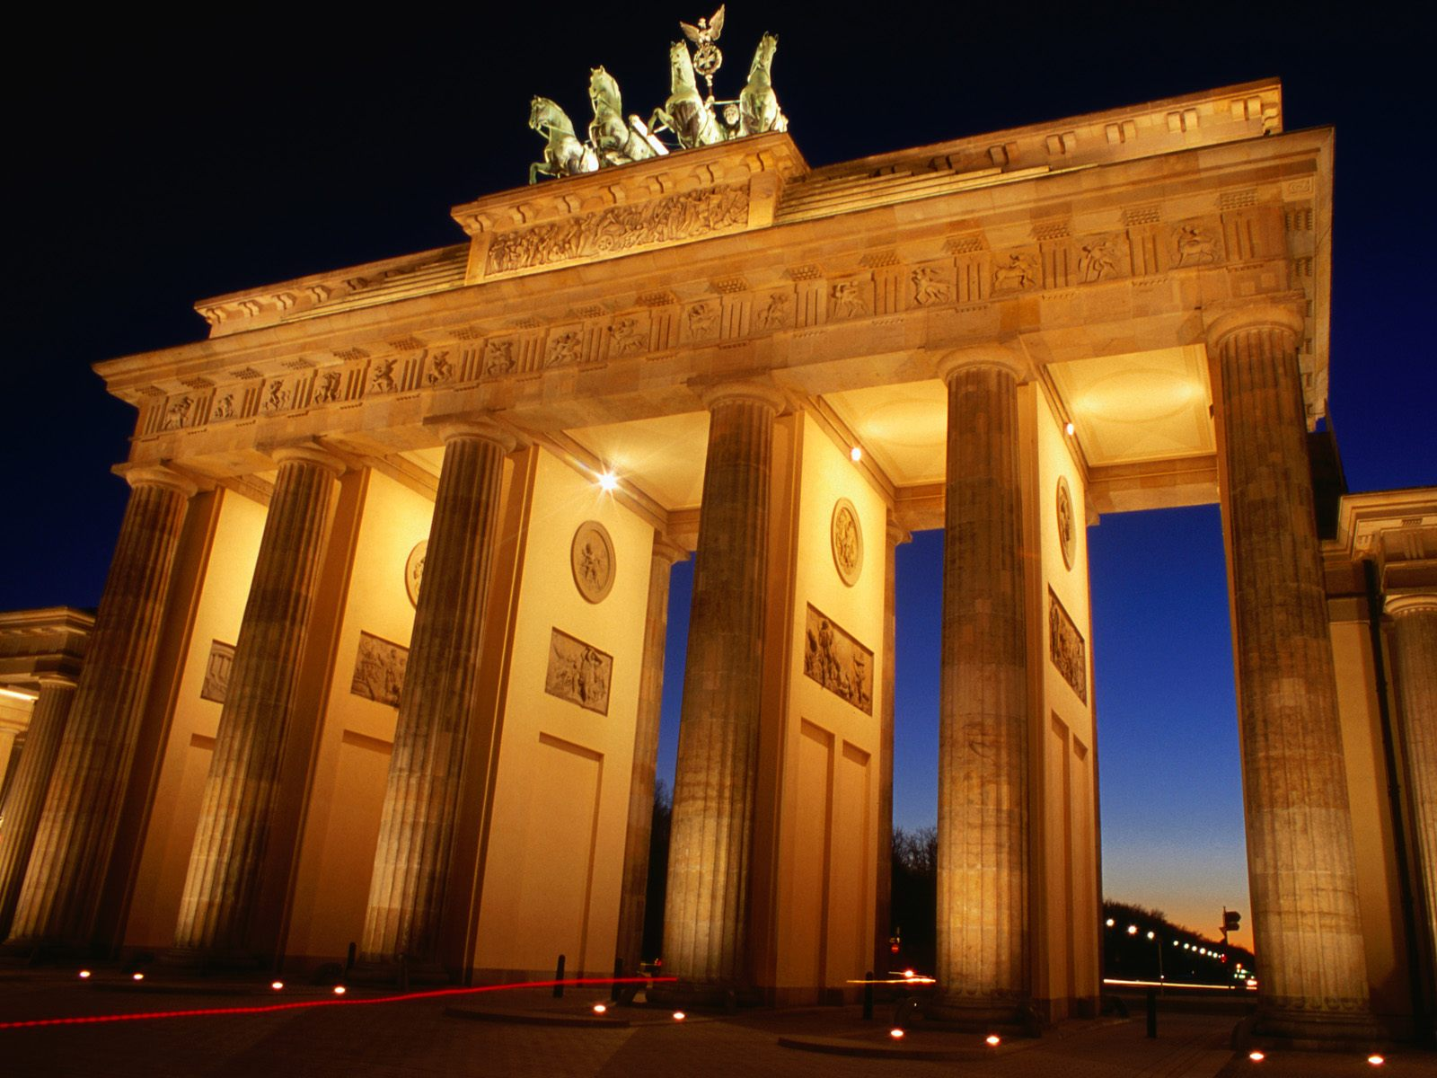
IRC Business Meeting Agenda
Welcome
Request for Additional Agenda Items (Number 7) and Approval of Agenda
President’s Report
A. Remembrances
B. Treasurer’s Report
C. IRS2012 (Proceedings, Participants, Presentations, & Banquet)
4. Selection of Officers for 2012–2016 term
5. Preview: Upcoming Nomination & Election of new IRC Members for 2012–2016 term
6. Working Group/Rapporteur Reports
7. Other Business
8. IRC-related Theme at DACA-13
9. Future IRC Business Meetings including “Heads-Up” on IRS2016 Bid Proposals

Slide 3

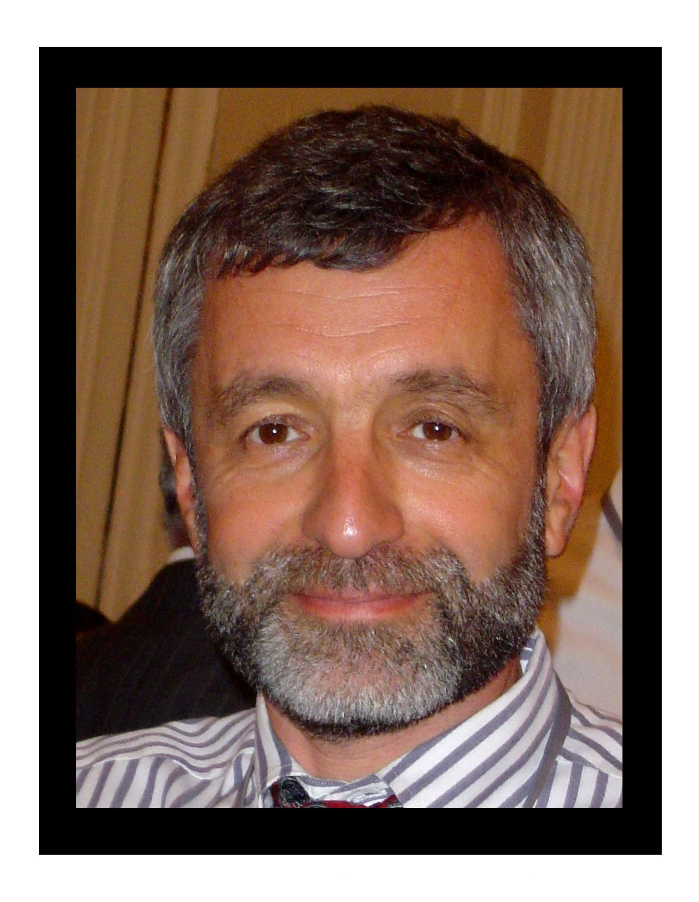
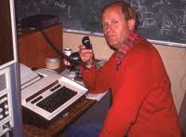
President’s Report
In Remembrance
Gregory Leptoukh 1953–2012
NASA GSFC
GES DISC, Giovanni, GEWEX Aerosol Panel
C. Martin R. Platt 1933–2012
CSIRO
Cloud physics, Explorer, ECLIPS

Slide 4
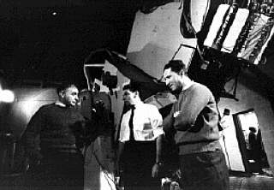
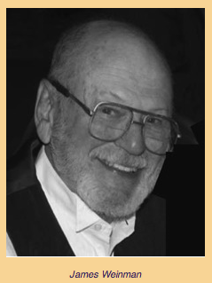
President’s Report
In Remembrance
Giorgio Fiocco 1931–2012
Terrestrial Physics, Radiation & Ozone Comm.
U. Roma
James Weinman 1930–2012
U WI, NASA-GSFC, UWash
δ-Eddington, lidar, m-wave,…

Slide 5
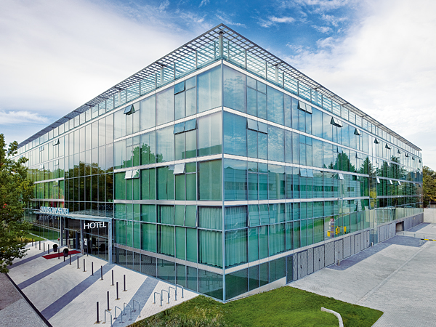
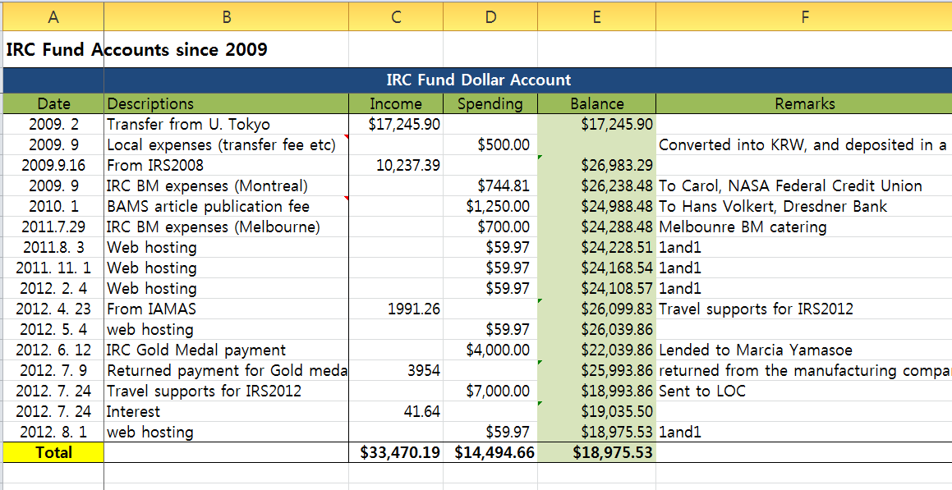
Treasurer’s Report
B.J. Sohn, Secretary, IRC
President’s Report
IRC fund balance (USD)

Slide 6
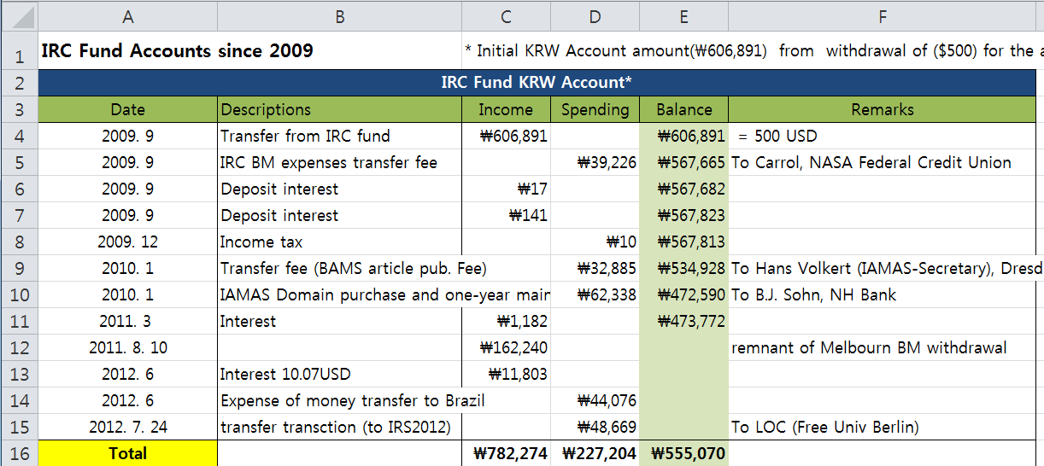
Treasurer’s Report
B.J. Sohn, Secretary, IRC
President’s Report
IRC fund balance (KRW)

Slide 7
President’s Report
IRS 2012 – Proceedings
AIP Conference Proceedings
Online Publication (perpetual open access) – proceedings available to all interested users in perpetuity, without need for username/password: Price = $4000 US
• Books and Dvds: Price depends on total number of pages and number of copies purchased
⬥ Book with inbound Dvd (minimum # of copies = 75)
⬥ Dvd only (minimum # of copies = 75)
Proceedings length in pages | Price per copy for 75-99 copies | Price per copy for 500-599 copies
900 | $88 US | $75 US
1100 | $92 US | $79 US
1800 | $118 US | $106 US
75 copies = $6600
500 copies = $37,500
75 copies = $8850
500 copies = $53,000
Proceedings length in pages | Price per copy For 75-99 copies | Price per copy For 500-599 copies
900 | $56 US | $42 US
1100 | $58 US | $44 US
1800 | $65 US | $51 US
75 copies = $4200
500 copies = $21,000
75 copies = $4875
500 copies = $25,500

Slide 8
President’s Report
IRS 2012 – Proceedings
Submitting a Proceedings Paper
– Authors submit papers directly to their respective Session Conveners via
email starting NOW through September 15. We encourage early submission!
– Format: Word document (.doc or .docx)
– Paper length: Four (4) pages or less including figures
– Submission Deadline: September 15, 2012
Proceedings Papers Editing Process
– Conveners review papers within their respective Sessions
– Conveners return papers to authors for revisions by October 17
– Authors submit revised papers to respective Session Conveners by October 31
– Session Conveners review revised papers
– Session Conveners forward revised and accepted papers to R. Cahalan and
C. Russell by November 14, 2012

Slide 9

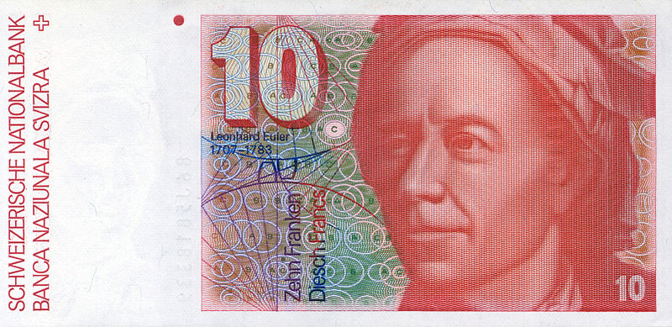
President’s Report
, 462, 520 are idoneal numbers
An idoneal number, also called a suitable number or convenient number, is a positive integer D for which the fact that a number is a monomorph (i.e., is expressible in only one way as x² ± Dy² where x² is relatively prime to Dy²) guarantees it to be a prime, prime power, or twice one of these. IFF not expressible as D = ab+bc+ca.
…also called Euler's idoneal numbers or suitable numbers.
Euler found the known 65 idoneal numbers up to 1848. At most one more exists, iff generalized Reimann conjecture is false.
Euler worked at the Berlin Academy 1741-1766, publishing 380 papers, 2 books, and “Letters to .. A German Princess”.
IRS 2012 – Participants
(as of mid-July)
Regular Registration 290
Student Registration 106
Accompanying Persons 12
Total 408
→ 462, 520 …
IRS 2012 – Presentations
Oral 300
Poster 275

Slide 10
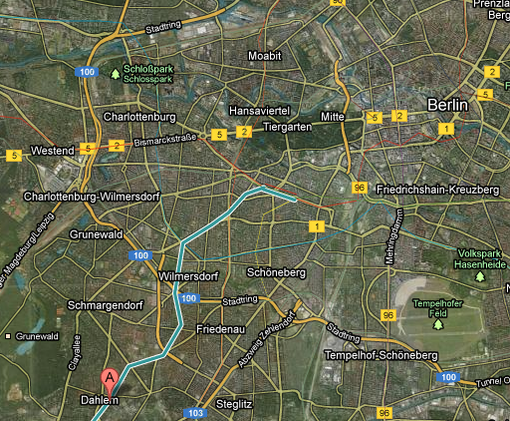
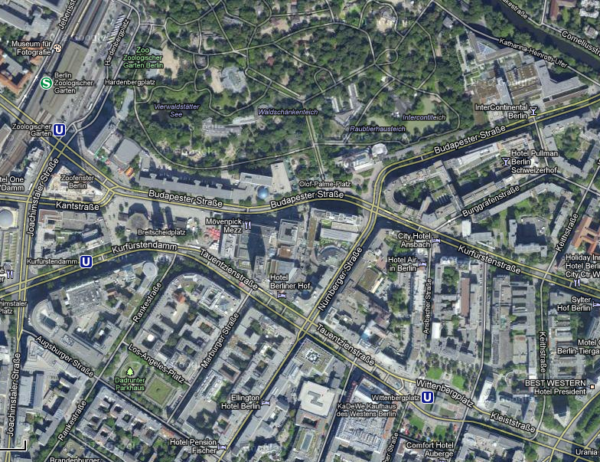
President’s Report
IRS 2012 Banquet
INTERCONTINENTAL HOTEL
BUDAPESTER STRASSE 2, BERLIN 10787
Subway Stops – two choices, each stop is about 1 km from hotel:
Wittenbergplatz U3 Line
OR Zoologischer Garten U9 or S5 Line
OR SHARE A TAXI!
Far view:
Closer view:
Zoologischer
Garten U9/S5
InterContinental Hotel
ZOO
Zoologischer Garten
•
ICH
•
Wittenbergplatz
U3 line
A = Dahlem Dorf
on U3
Wittenbergplatz U3

Slide 11
Selection of Officers for 2012–2016 Term
Voting Procedures for Officers
Detailed procedures on website → http://www.irc-iamas.org/resources/ → “Voting Procedure for Officers”
Nomination of a Candidate for President During the last year of term, the sitting IRC President forms a Nominating
Committee - 2 or more additional individuals - past Presidents. Sitting IRC President and Nom. Comm. select candidate for President by consensus or vote if necessary
Nomination of a Candidate for Vice President + Candidate for Secretary Nominee for President, sitting President &
Nom. Comm. select Nominee for VP and Nominee for Secretary by consensus or vote if necessary
Election of President and His/Her Slate of Vice President and Secretary Election of new President of IRC must be on
agenda of the last IRC business meeting of a term
Nominee for President is presented to members in attendance at business meeting
Nominee for President in turn presents his/her “slate” of nominees for VP & Secretary
All members present at business meeting VOTE FOR OR AGAINST electing the Nominee as the new President for the
following term. Each member has one vote. The new President is elected by a simple majority of affirmative votes.
In the case of a tie, the vote of the sitting IRC president decides the outcome of the election.
If the Nominee for President is elected, then his/her nominees for VP & Secretary are automatically elected
If the Nominee for President is not elected, then his/her nominees are also not elected (no separate votes for VP & Sec)
If the Nom. for President is not approved, then the steps of selecting Pres, VP & Sec must be reiterated at a time
subsequent to the business meeting. Subsequent voting would take place by email.
Once a Nominee for President has been approved, the full slate of officers selected by the above process shall be declared elected, and announced to the full membership and the officers of IAMAS by any effective means of communication.

Slide 12
Selection of Officers for 2012–2016 Term
Voting Procedures for Officers
Detailed procedures on website → http://www.irc-iamas.org/resources/ → “Voting Procedure for Officers”
Nomination of a Candidate for President During the last year of term, the sitting IRC President forms a Nominating
Committee – R. Cahalan, H. Fischer, & T. Nakajima. Sitting IRC President and Nom. Comm. select candidate for President by consensus or vote if necessary ➔ Werner Schmutz
Nomination of a Candidate for Vice President + Candidate for Secretary Nominee for President, sitting President &
Nom. Comm. select Nominee for VP and Nominee for Secretary by consensus or vote if necessary
Election of President and His/Her Slate of Vice President and Secretary Election of new President of IRC must be on
agenda of the last IRC business meeting of a term
Nominee for President is presented to members in attendance at business meeting
Nominee for President in turn presents his/her “slate” of nominees for VP & Secretary
All members present at business meeting VOTE FOR OR AGAINST electing the Nominee as the new President for the
following term. Each member has one vote. The new President is elected by a simple majority of affirmative votes.
In the case of a tie, the vote of the sitting IRC president decides the outcome of the election.
If the Nominee for President is elected, then his/her nominees for VP & Secretary are automatically elected
If the Nominee for President is not elected, then his/her nominees are also not elected (no separate votes for VP & Sec)
If the Nom. for President is not approved, then the steps of selecting Pres, VP & Sec must be reiterated at a time
subsequent to the business meeting. Subsequent voting would take place by email.
Once a Nominee for President has been approved, the full slate of officers selected by the above process shall be declared elected, and announced to the full membership and the officers of IAMAS by any effective means of communication.

Slide 13
Selection of Officers for 2012–2016 Term
Voting Procedures for Officers
Detailed procedures on website → http://www.irc-iamas.org/resources/ → “Voting Procedure for Officers”
Nomination of a Candidate for President During the last year of term, the sitting IRC President forms a Nominating
Committee – R. Cahalan, H. Fischer, & T. Nakajima. Sitting IRC President and Nom. Comm. select candidate for President by consensus or vote if necessary ➔ Werner Schmutz
Nomination of a Candidate for Vice President + Candidate for Secretary Nominee for President, sitting President &
Nom. Comm. select Nominee for VP and Nominee for Secretary by consensus or vote if necessary ➔ B.J. Sohn (VP) and Peter Pilewskie (Sec)
Election of President and His/Her Slate of Vice President and Secretary Election of new President of IRC must be on
agenda of the last IRC business meeting of a term
Nominee for President is presented to members in attendance at business meeting
Nominee for President in turn presents his/her “slate” of nominees for VP & Secretary
All members present at business meeting VOTE FOR OR AGAINST electing the Nominee as the new President for the
following term. Each member has one vote. The new President is elected by a simple majority of affirmative votes.
In the case of a tie, the vote of the sitting IRC president decides the outcome of the election.
If the Nominee for President is elected, then his/her nominees for VP & Secretary are automatically elected
If the Nominee for President is not elected, then his/her nominees are also not elected (no separate votes for VP & Sec)
If the Nom. for President is not approved, then the steps of selecting Pres, VP & Sec must be reiterated at a time
subsequent to the business meeting. Subsequent voting would take place by email.
Once a Nominee for President has been approved, the full slate of officers selected by the above process shall be declared elected, and announced to the full membership and the officers of IAMAS by any effective means of communication.

Slide 14

Presentation of 2012-2016 Officer Slate
FOR PRESIDENT: Werner Schmutz PMOD/WRC
FOR VICE-PRESIDENT: B. J. Sohn Seoul National University
FOR SECRETARY: Peter Pilewskie Univ. of Colorado/LASP
Next:
Nominees exit room
Vote on Officer Slate

Slide 15
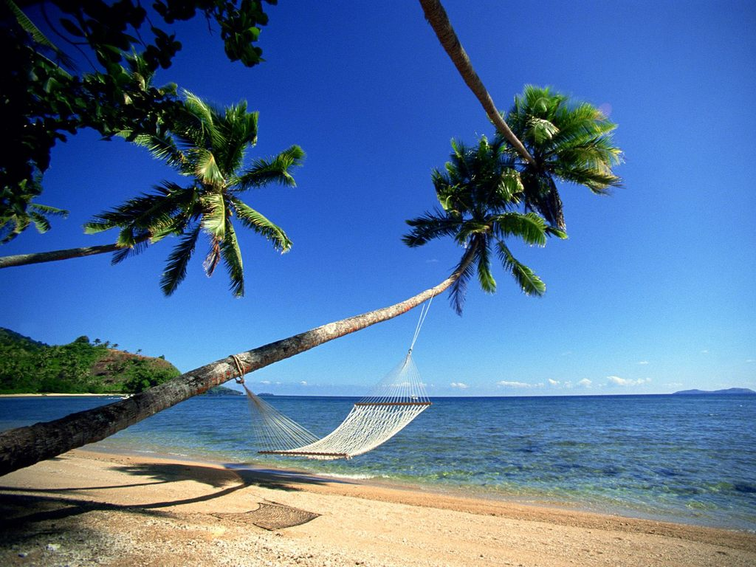
Expirations and Resignations
Bruce Forgan AUSTRALIA
L.J. Bruce McArthur CANADA
Clemens Simmer GERMANY
Paolo Di Girolamo ITALY
Teruo Aoki JAPAN
Tadahiro Hayasaka JAPAN
Harold Annegarn SOUTH AFRICA
Stephen English UK
Allen Huang USA
Allen Larar USA
The IRC extends a heartfelt thank you to these members
for their years of service!

Slide 16

Upcoming Nomination & Election of
New Members for 2012–2016 term
Detailed procedures on website at http://www.irc-iamas.org/resources/ ➔ “Voting Procedure for Members”
Rules for the Selection of IRC Members
After selection of the new IRC President, IRC Secretary distributes a call for nominations for new IRC members
to replace members whose terms expire. Anyone nominated by an IRC member is included on the ballot.
Guidelines for nominating individuals for IRC membership:
Geographic/other diversity. The Commission must reflect its international status, and capture a diversity of
disciplines & other aspects of scientists engaged in atmospheric radiation studies.
Recommendation of scientists actively engaged in IRC pursuits and interests.
Recommendation of scientists who demonstrate outstanding academic achievement.
The IRC Secretary will assemble & distribute a ballot of nominees to voting members.
Members, including those whose terms are expiring, may vote for as many of the nominees as they choose.
Only “affirmative” votes are counted; votes “against” are not accepted.
Election Requirements, Special Considerations and Appointments
To be elected, nominees must satisfy two criteria. Election is by
(a) simple majority (the integer part of 50% + 1 of the total votes cast), and
(b) ranking within the top three per country/area.
Only nominated individuals can be elected. Write-in votes are not accepted.
There is no vested right regarding an allocated number of IRC members for any given nation.
Representation from adhering nations is encouraged but not required.
The outgoing President may choose to appoint one or more nominees from any country/area considered to
be underrepresented in the IRC who did not otherwise satisfy election requirements.

Slide 17
Working Group and Rapporteur Reports
Please emphasize up to 3 actionable recommendations
– Keep remarks to 5 minutes please –
3DRT Marshak
ASA/Hitran Rothman Report on IRC website, Sep 2012
CIRC Oreopoulos
GEB Wild
IPRT Mayer
ITWG Huang
LASR Hayasaka
UV Gröbner
BSRN König-Langlo
CR Kinne
  GRP Kummerow Report on IRC website

Slide 18
Other Business

Slide 19

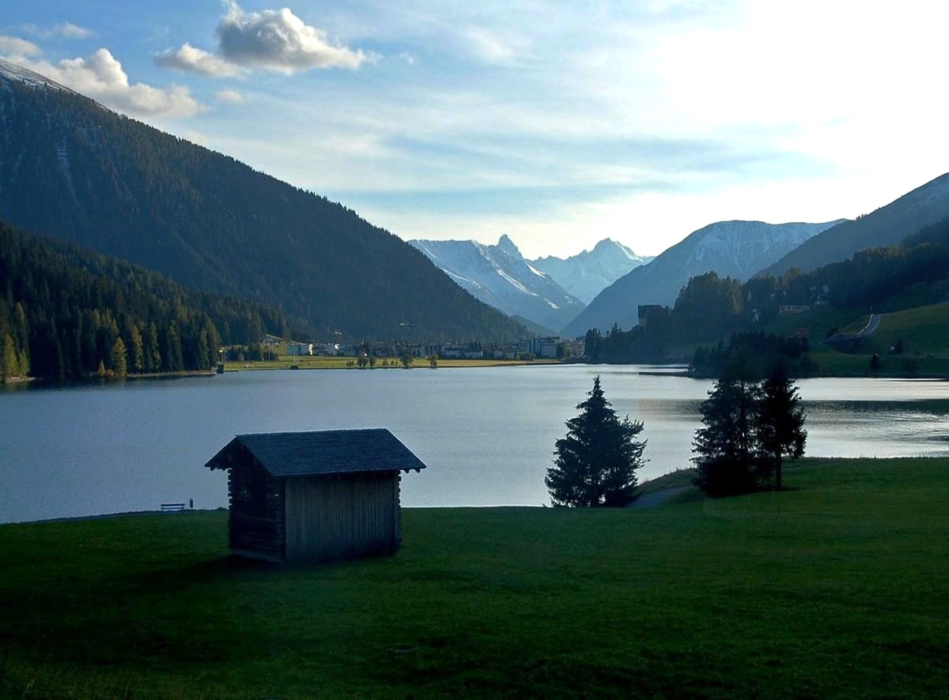
Davos Atmosphere and Cryosphere Assembly 2013
IAMAS & IACS Assembly
Davos, Switzerland July 8-12, 2013
www.daca-13.org
IRC-related theme:
Stratosphere-Troposphere-Hydrosphere-Cryosphere Coupling
in Weather and Climate Including Sun-Earth Connection Processes

Slide 20
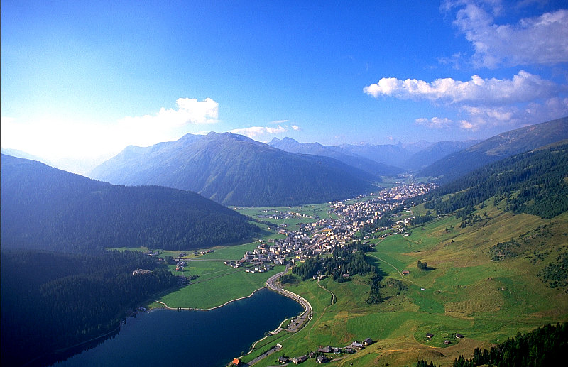
Future IRC Business Meetings
– 2013 DACA-13 Day before/after conference - Jul 7 or 13
– 2014 Propose meetings in the Americas or Asia, also
COSPAR Aug. 2-10, Moscow, Russia is a possibility
– 2015 IUGG Assembly Prague, Czech Republic
– 2016 Next IRS ➔ Call for proposals!

Slide 21
Backup Slides

Slide 22
Contingency Upon Non-Election of Candidate Officer Slate
If the Nominee for President is not elected, then his or her nominees are also not elected. There are no separate votes for Vice-President and Secretary.
Contingency Election. If the Nominee for President is not approved then the following steps must be reiterated at a time subsequent to the business meeting: Nomination of a Candidate for President
Nomination of a Candidate for Vice President + Candidate for Secretary
Once a new Nominee for President and his/her slate of Nominees for Vice-President and Secretary are determined, the slate must be presented to the full membership for a vote. Votes may be collected by any effective means of communication. This process must occur in a timely manner, with the announcement of a new slate and election taking place as soon as possible after the IRC Business Meeting.

