Slide 1
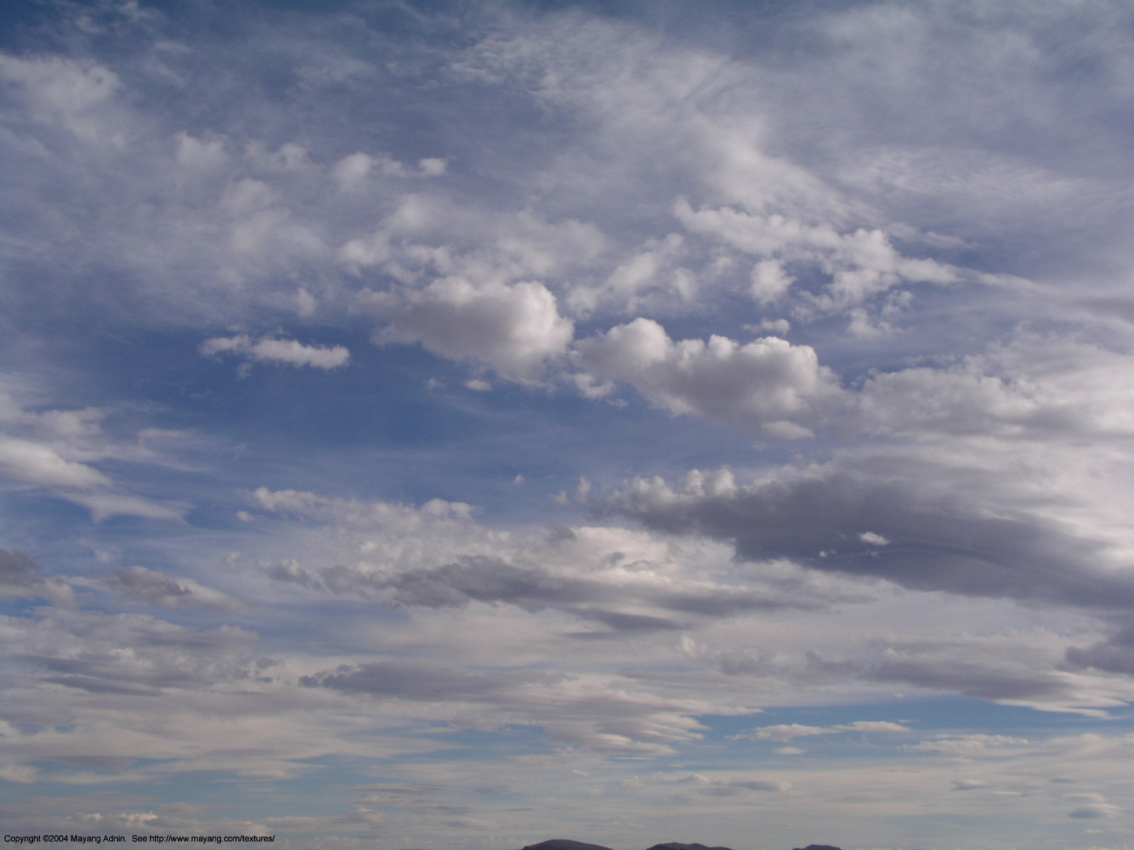
The Continual Intercomparison of Radiation Codes (CIRC)
Report to IRC, July 2010
Lazaros Oreopoulos¹ and Eli Mlawer²
¹NASA-GSFC, Greenbelt, MD, USA (Chair)
²AER, Lexington, MA, USA (co-Chair)

Slide 2
What CIRC is about
RT model intercomparison aspiring to become the standard for documenting the performance of RT codes used in Large-Scale Models (LSMs)
Working group within IRC and GRP
Goal is to have RT codes of GCMs (incl. IPCC) report performance against CIRC
Phase 1 was launched on June 4, 2008
Phase “1a” was launched on January 19, 2010 (16 simpler variants of Phase I cases)
Website: http://circ.gsfc.nasa.gov
How CIRC differs from previous intercomparisons:
Observation-tested (LW) LBL calculations are used as radiative benchmarks
Benchmark results are publicly available
Observationally-based input (from an ARM product named BBHRP, mostly)
Flexible structure and longer lifespan than previous intercomparisons

Slide 3
Longwave code participants
Model Index | Brief Model Description | In LSM? | Experiment variants | Submitted By | Reference(s)
0 | LBLRTM v.11.1/HITRAN 2004, MT_CKD_2.0, AER_V_2.0 | No | None | Delamere, Mlawer | Clough et al. (2005)
1 | RRTM-LW, 10-3000 cm⁻¹, CKD, 16 bands, 256 g-points | No | None | Iacono, Mlawer | Mlawer et al. (1997); Clough et al. (2005);
2 | RRTMG-LW, 10-3000 cm⁻¹, CKD, 16 bands, 140 g-points | Yes | None | Iacono | Mlawer et al. (1997); Iacono et al. (2008)
3 | CLIRAD-LW, 0-3000 cm⁻¹, k-distribution and one-parameter scaling, 10 bands, 85/113 k-points | Yes | “High/Low” accuracy, with/without scattering | Oreopoulos | Chou et al. (2003)
4 | CCC 0-2500 cm⁻¹, CKD, 9 bands, 56 g-points | Yes | With/without scattering | Cole, Li | Li (2002); Li and Barker (2002); Li and Barker (2005);
5 | FLBLM, 40-3000 cm⁻¹, line-by-line, | No | None | Fomin | Fomin (2006)
6 | FKDM, 40-3000 cm⁻¹, CKD, 23 g-points | No | None | Fomin | Fomin (2004)
7 | CAM 3.1, 0-2000 cm⁻¹, absorptiviy-emissivity approach | Yes | Treatment of lowest level air temperature | Oreopoulos | Collins et al. (2004)
8 | FLCKKR (LW), 0-2200 cm⁻¹, CKD, 12 bands, 67 g-points | No | None | Rose, Kratz, Kato, Charlock | Fu and Liou (1992); Fu et al. (1997)
9 | RRTMG-LW (as implemented in FMI NWP), 10-3000 cm⁻¹, 16 bands, 140 g-points | Yes | None | Räisänen | Mlawer et al. (1997); Iacono et al. (2007)
10 | ES, 10-3000 cm⁻¹, 9 bands, ESF of band transmissions | Yes | With/without scattering | Manners | Edwards and Slingo (1996); Edwards (1996)
11 | GISS, 50-2000 cm⁻¹, CKD, 33 g-points | Yes | None | Zhang, Rossow, Lacis | Zhang et al. (2004)

Slide 4
Shortwave code participants
Model Index | Brief Model Description | In LSM? | Experiment variants | Submitted By | Reference(s)
0 | CHARTS v.4.04/LBLRTM v.11.1/ HITRAN2004, line-by-line | No | None | Delamere, Mlawer | Moncet and Clough (1997); Clough et al. (2005)
1 | RRTM-SW, 0.2-12.2 µm, CKD, 14 bands, 224 g-points | No | None | Iacono, Mlawer | Clough et al. (2005)
2 | RRTMG-SW, 0.2-12.2 µm , CKD, 14 bands, 112 g-points | Yes | None | Iacono, Mlawer | Iacono et al. (2008)
3 | CLIRAD-SW, 0.175-10 µm, 11 bands, pseudo-monochromatic/k-distribution hybrid, 38 k-points | Yes | Two R_{sfc} averaging methods | Oreopoulos | Chou et al. (1998); Chou and Suarez (2002)
4 | CCC, 0.2-9.1 µm, CKD, 4 bands, 40 g-points | Yes | Three R_{sfc} averaging methods | Cole, Li | Li and Barker (2005); Li et al. (2005)
5 | FLBLM/ HITRAN 11v, 0.2-10 µm, line-by-line | No | None | Fomin | Fomin and Mazin (1998)
6 | FKDM, 0.2-10 µm, CKD, 15 g-points | No | Two treatments of cloud optical properties | Fomin | Fomin and Correa (2005)
7 | CAM 3.1, 0.2-5.0 µm, 19 spectral and pseudo-spectral intervals, | Yes | Two R_{sfc} averaging methods | Oreopoulos | Briegleb (1992); Collins (2001); Collins et al. (2004)
8 | FLCKKR (SW), 0.17-4.0 µm, CKD, 18 bands, 69 g-points | No | Two R_{sfc} averaging methods | Rose, Kratz, Kato, Charlock | Fu and Liou (1992)
9 | FMI, 0.185-4 µm, 6 bands, Padé approximants to fit transmission functions | Yes | Two R_{sfc} averaging methods | Räisänen | Fouquart and Bonnel (1980); Cagnazzo et al. (2007)
10 | Edwards-Slingo 0.2-10 µm, 6 bands, ESF of band transmissions | Yes | Two R_{sfc} averaging methods | Manners | Edwards and Slingo (1996)
11 | NASA-GISS v. D, 0.2-5.0 µm, CKD, 15 g-points | Yes | Three R_{sfc} averaging methods | Zhang, Rossow, Lacis | Zhang et al. (2004)
12 | COART, 0.25-4.0 µm, 26 bands, k-distribution | No | None | Jin, Charlock | Jin et al. (2006)
13 | CLIRAD-SW modified, 0.2 -10 µm, 8 bands, k-distribution 15 k-points | No | Two R_{sfc} averaging methods | Oreopoulos | Tarasova and Fomin (2007)

Slide 5
CIRC 2010 activities and status
Phase 1 sub-cases (“Phase 1a”) released in January 2010 and an almost complete suite of new submissions was received
Overview and promotion paper published in February 2010 issue of BAMS
Technical paper on Phase I under preparation (to be submitted to JGR)
Oral presentation on Phase I highlights at 13th AMS Meeting on Atmospheric Radiation, Portland OR, June 2010
Preproposal asking CIRC funding from the ASR (formerly ARM) program rejected because of violation of “one proposal per PI rule” (chair and co-chair each had other preproposals submitted)
CIRC soon to be completely unfunded (current funding of co-chair is minimal and will soon expire)
Have not been able to draw attention of IPCC. Many codes used in IPCC GCMs and to generate global radiation flux datasets (e.g., GEWEX SRB, CloudSat 2B-FLXHR) have not participated.
CIRC urges stronger IRC advocacy to help with funding, consolidation of CIRC as de facto RT code evaluation standard, and expansion of participation.

