Slide 1
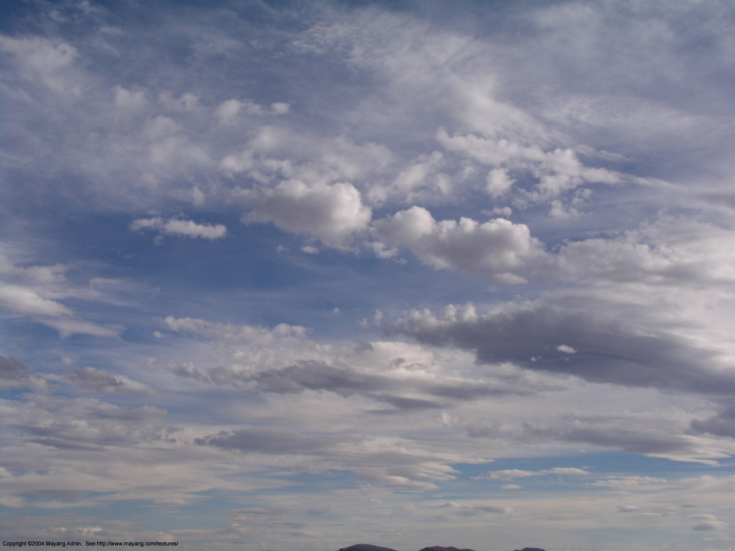
The Continual Intercomparison of Radiation Codes (CIRC)
Status report to IRC, August 2012
Lazaros Oreopoulos¹ and Eli Mlawer²
¹NASA-GSFC, Greenbelt, MD, USA (Chair)
²AER, Lexington, MA, USA (co-Chair)

Slide 2
What CIRC is about
RT model intercomparison intended to be the standard for documenting the performance of RT codes used in Large-Scale Models (LSMs)
Working group within IRC and (now) GEWEX’s GASS (ex-GCSS)
Goal is to have RT codes of GCMs (incl. IPCC) report performance against CIRC
Phase 1 was launched on June 4, 2008
Phase “1a” was launched on January 19, 2010 (16 simpler variants of Phase I cases)
Phase I (1 and 1a) is essentially completed
Website: http://circ.gsfc.nasa.gov
How CIRC differs from previous intercomparisons:
Observation-tested (LW) LBL calculations are used as radiative benchmarks
Benchmark results are publicly available
Observationally-based input (chiefly from an ARM product named BBHRP)
Intended to have flexible structure and be continual (i.e. updated periodically)

Slide 3
Longwave code participants
Model Index | Brief Model Description | In LSM? | Experiment variants | Submitted By | Reference(s)
0 | LBLRTM v.11.1/HITRAN 2004, MT_CKD_2.0, AER_V_2.0 | No | None | Delamere, Mlawer | Clough et al. (2005)
1 | RRTM-LW, 10-3000 cm⁻¹, CKD, 16 bands, 256 g-points | No | None | Iacono, Mlawer | Mlawer et al. (1997); Clough et al. (2005);
2 | RRTMG-LW, 10-3000 cm⁻¹, CKD, 16 bands, 140 g-points | Yes | None | Iacono | Mlawer et al. (1997); Iacono et al. (2008)
3 | CLIRAD-LW, 0-3000 cm⁻¹, k-distribution and one-parameter scaling, 10 bands, 85/113 k-points | Yes | “High/Low” accuracy | Oreopoulos | Chou et al. (2003)
4 | CCC 0-2500 cm⁻¹, CKD, 9 bands, 56 g-points | Yes | With/without scattering | Cole, Li | Li (2002); Li and Barker (2002); Li and Barker (2005);
5 | FLBLM, 40-3000 cm⁻¹, line-by-line, | No | With/without scattering | Fomin | Fomin (2006)
6 | FKDM, 40-3000 cm⁻¹, CKD, 23 g-points | No | None | Fomin | Fomin (2004)
7 | CAM 3.1, 0-2000 cm⁻¹, absorptiviy-emissivity approach | Yes | None | Oreopoulos | Collins et al. (2004)
8 | FLCKKR (LW), 0-2200 cm⁻¹, CKD, 12 bands, 67 g-points | No | None | Rose, Kratz, Kato, Charlock | Fu and Liou (1992); Fu et al. (1997)
9 | RRTMG-LW (as implemented in FMI ECHAM5.4), 10-3000 cm⁻¹, 16 bands, 140 g-points | Yes | None | Räisänen | Mlawer et al. (1997); Iacono et al. (2007)
10 | ES, 10-3000 cm⁻¹, 9 bands, ESF of band transmissions | Yes | With/without scattering | Manners | Edwards and Slingo (1996); Edwards (1996)
11 | GISS, 50-2000 cm⁻¹, CKD, 33 g-points | Yes | With/without scattering | Zhang, Rossow, Lacis | Zhang et al. (2004)

Slide 4
Shortwave code participants
Model Index | Brief Model Description | In LSM? | Experiment variants | Submitted By | Reference(s)
0 | CHARTS v.4.04/LBLRTM v.11.1/ HITRAN2004, line-by-line | No | None | Delamere, Mlawer | Moncet and Clough (1997); Clough et al. (2005)
1 | RRTM-SW, 0.2-12.2 µm, CKD, 14 bands, 224 g-points | No | None | Iacono, Mlawer | Clough et al. (2005)
2 | RRTMG-SW, 0.2-12.2 µm , CKD, 14 bands, 112 g-points | Yes | None | Iacono, Mlawer | Iacono et al. (2008)
3 | CLIRAD-SW, 0.175-10 µm, 11 bands, pseudo-monochromatic/k-distribution hybrid, 38 k-points | Yes | Two R_{sfc} averaging methods | Oreopoulos | Chou et al. (1998); Chou and Suarez (2002)
4 | CCC, 0.2-9.1 µm, CKD, 4 bands, 40 g-points | Yes | Three R_{sfc} averaging methods | Cole, Li | Li and Barker (2005); Li et al. (2005)
5 | FLBLM/ HITRAN 11v, 0.2-10 µm, line-by-line | No | None | Fomin | Fomin and Mazin (1998)
6 | FKDM, 0.2-10 µm, CKD, 15 g-points | No | Two treatments of cloud optical properties | Fomin | Fomin and Correa (2005)
7 | CAM 3.1, 0.2-5.0 µm, 19 spectral and pseudo-spectral intervals, | Yes | Two R_{sfc} averaging methods | Oreopoulos | Briegleb (1992); Collins (2001); Collins et al. (2004)
8 | FLCKKR (SW), 0.175-4.0 µm, CKD, 18 bands, 69 g-points | No | Two R_{sfc} averaging methods | Rose, Kratz, Kato, Charlock | Fu and Liou (1992)
9 | FMI/ECHAM5.4, 0.185-4 µm, 6 bands, Padé approximants to fit transmission functions | Yes | Two R_{sfc} averaging methods | Räisänen | Fouquart and Bonnel (1980); Cagnazzo et al. (2007)
10 | Edwards-Slingo 0.2-10 µm, 6 bands, ESF of band transmissions | Yes | Two R_{sfc} averaging methods | Manners | Edwards and Slingo (1996)
11 | NASA-GISS v. D, 0.2-5.0 µm, CKD, 15 g-points | Yes | Three R_{sfc} averaging methods | Zhang, Rossow, Lacis | Zhang et al. (2004)
12 | COART, 0.25-4.0 µm, 26 bands, k-distribution | No | None | Jin, Charlock | Jin et al. (2006)
13 | CLIRAD-SW modified, 0.2 -10 µm, 8 bands, k-distribution 15 k-points | No | Two R_{sfc} averaging methods | Oreopoulos | Tarasova and Fomin (2007)

Slide 5
CIRC activities since last report and status
Completed Phase I in late 2011.
JGR-Atmos paper published March 2012 (promoted as an ARM research highlight)
Moved from GEWEX’s GRP (now GDAP) to GEWEX’s GASS (ex-GCSS) (unclear how this will affect CIRC direction)
CIRC presentation (poster) at this meeting
CIRC presentation forthcoming in Pan-GASS meeting September 2012
Mlawer presented to WGCM/WGNE meeting in October 2011 following letter of IRC to WGCM (Bony)
Unfinished business: Post submissions of Phase I participants on CIRC website
CIRC remains unfunded

Slide 6
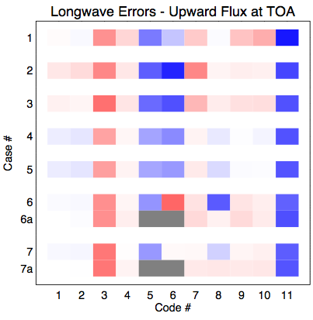
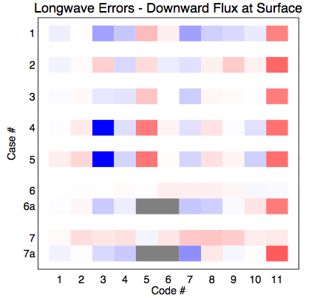
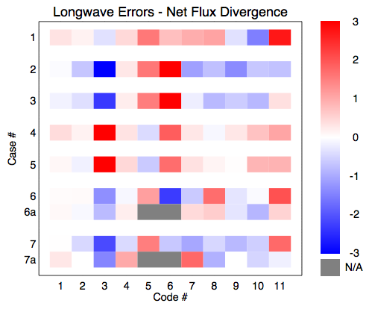
Model-LBL (%)

Slide 7
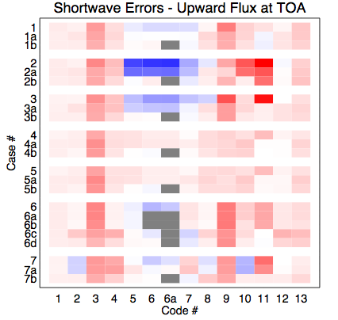
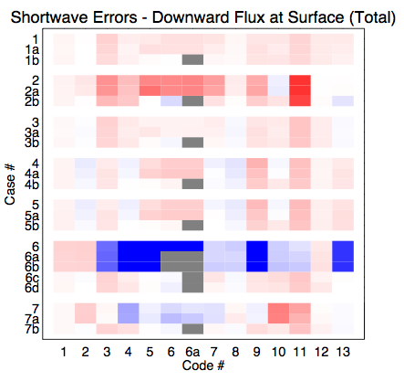

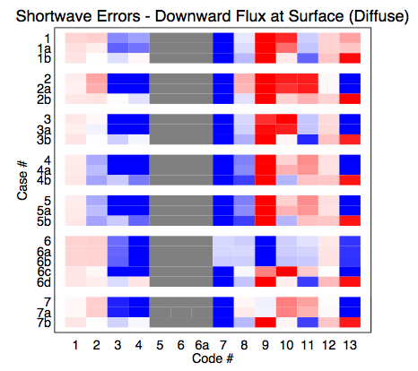
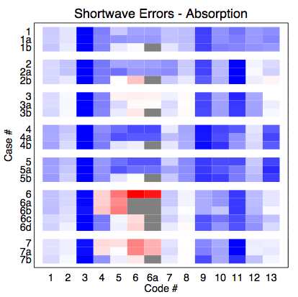
Model-LBL (%)

Slide 8
Overall performance

Slide 9
Recommendations to IRC
Continued IRC advocacy to help with funding, consolidation of CIRC as de facto RT code evaluation standard, and expansion of participation.
Follow-up from our WGCM interactions. Will there be anything in IPCC about RT code quality in CMIP5 GCMs, what is WGCM doing to encourage this?
Reach out to GASS to see the degree to which their and IRC’s vision about CIRC match
State that RT codes used for reconstruction of radiation budgets from geophysical parameter retrievals need to be evaluated via CIRC
Direct communication with project managers of radiation-related science at NASA, DOE and NOAA to encourage funding of Phase II.

Slide 10
Intercomparison of shortwave radiative transfer schemes in global aerosol modeling: Results from the AeroCom Radiative Transfer Experiment
C. A. Randles^{1,2}, S. Kinne³, G. Myhre⁴, M. Schulz⁵, P. Stier⁶, J. Fischer⁷, L. Doppler^{7,8}, E. Highwood⁹, C. Ryder⁹, B. Harris⁹, J. Huttunen¹⁰, Y. Ma¹¹, R. T. Pinker¹¹, B. Mayer¹², D. Neubauer^{13,14}, R. Hitzenberger^{13,14}, L. Oreopoulos*¹⁵, D. Lee^{15,16}, G. Pitari¹⁷, G. Di Genova^{17,18}, Fred G. Rose^{19,20}, S. Kato²⁰, S. T. Rumbold²¹, I. Vardavas²², N. Hatzianastassiou²³, C. Matsoukas²⁴, H. Yu^{25,15}, F. Zhang²⁵, H. Zhang²⁶, P. Lu²⁶
*Presenting Author: L. Oreopoulos
¹GESTAR/Morgan State University, Baltimore, Maryland, USA
²NASA Goddard Space Flight Center (GSFC) Atmospheric Chemistry and Dynamics Lab, Greenbelt, MD, USA
³Max Plank Institute for Meteorology, Hamburg, Germany
⁴Center for International Climate and Environmental Research-Oslo (CICERO), Oslo, Norway
⁵Meteorologisk Institutt, Oslo, Norway
Department of Physics, University of Oxford, United Kingdom
⁷Institut für Weltraumwissenschaften, Freie Universität, Berlin, Germany⁸LATMOS-IPSL, Paris, France
⁹Department of Meteorology, University of Reading, United Kingdom
¹⁰Finnish Meteorological Institute, Kuopio, Finland
¹¹Department of Meteorology, University of Maryland College Park, USA
¹²Ludwig-Maximilians-Universitaet, Munich, Germany
¹³Research Platform: ExoLife, University of Vienna, Austria
¹⁴Faculty of Physics, University of Vienna, Austria
¹⁵NASA GSFC Climate and Radiation Laboratory, Greenbelt, Maryland, USA
¹⁶Seoul National University, Republic of Korea
¹⁷Department of Physical and Chemical Sciences, University of L'Aquila, Italy
¹⁸Space Academy Foundation, Fucino Space Center, Italy
¹⁹SSAI, Hampton, VA, USA ²⁰NASA Langley Research Center (LaRC), Hampton, Virginia, USA
²¹UK Met Office (UKMO) Hadley Center, Exeter, United Kingdom
²²Department of Physics, University of Crete, Greece
²³Laboratory of Meteorology, Department of Physics, University of Ioannina, Greece
²⁴Department of Environment, University of the Aegean, Greece
²⁵Earth System Science Interdisciplinary Center (ESSIC), University of Maryland, College Park, Maryland, USA
²⁶Laboratory for Climate Studies, CMA, National Climate Center, Beijing, China

Slide 11
Participating Models
Model | Name | Multiple-Scattering | Gaseous Transmission | Prescribed (P) or Direct Effect (D) AeroCom Experiment?
1 | GENLN2-DISORT | 16-stream DISORT | Line-by-line, 0.02 cm⁻²
2 | RFM DISORT (RFMD) | 4-stream DISORT | Line-by-line, 1 cm⁻²
3 | Oslo-DISORT | 8-stream DISORT | ESFT | P, D
4 | UNIVIE-Streamer | 8-stream DISORT | ESFT
5 | FMI-libRadtran | 8-stream DISORT2 + δ-M scaling | ESFT
6 | LMU-libRadtran | 6-stream DISORT | ESFT
7 | GSFC-FLG | 4-stream δ-Eddington | correlated-k
8 | CAR-FLG | 4-stream δ-Eddington | correlated-k
9 | LaRC-FL | 2-stream δ-Eddington | correlated-k
10 | CAR-RRTMG | 2-stream δ-Eddington | correlated-k | P, D
11 | RRTMG-SW | 2-stream δ-Eddington | correlated-k | P, D
12 | LMU-2stream | 2-stream δ-Eddington | correlated-k
12 | MIP-2stream | 2-stream δ-Eddington | correlated-k | P
14 | CAR-GSFC | 2-stream δ-Eddington + adding | correlated-k | P, D
15 | BCC-RAD | 2-stream δ-Eddington | correlated-k | D
16 | CAR-CCCMA | 2-stream δ-Eddington + adding | correlated-k
17 | UMD-SRB | 2-stream δ-Eddington | correlated-k
18 | ES96-6 | 2-stream PIFM | correlated-k
19 | ES96-220 | 2-stream PIFM | correlated-k
20 | ES96-6-D | 2-stream PIFM w/δ-rescaling | correlated-k
21 | ES96-220-D | 2-stream PIFM w/δ-rescaling | correlated-k
22 | UKMO-HadGEM2 | 2-stream PIFM w/δ-rescaling | correlated-k | D
23 | CAR-CAWCR | 2-stream δ-Eddington | ESFT
24 | CAR-CAM | 2-stream δ-Eddington | ESFT
25 | ULAQ | 2-stream δ-Eddington | ESFT
26 | FORTH | 2-stream δ-Eddington | ESFT
27 | CAR-GFDL | 2-stream δ-Eddington + adding | ESFT
28 | MPI-MOM | 10-stream Matrix-Operator adding-doubling | correlated-k
29 | MOMO | Matrix-Operator adding-doubling | non-correlated-k
29 Participating models!!!
2 line-by-line (LBL) benchmarks
Multiple Scattering:
  10 codes (including LBL) have > 2 streams
  6 codes use discrete ordinate method (DISORT)
  21 use some variant of delta Eddington (δ-Eddington)
  2 use matrix operator method (MOM)
Gaseous Transmission:
  9 codes use exponential sum fit transmission (ESFT)
  16 use correlated-k
  1 uses non-correlated k
Relationship to other AeroCom experiments:
5 codes also used in AeroCom Prescribed Experiment (Stier et al., 2012)
5 codes also used in AeroCom Direct Effect Experiment (Myhre et al., 2012)

Slide 12
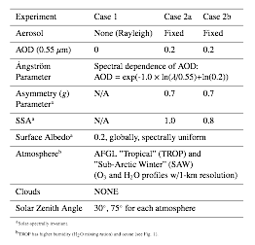
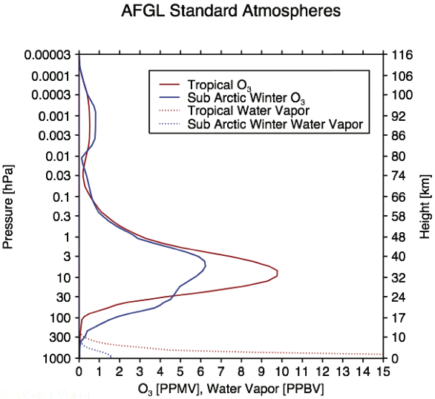
Experiment Protocol
Three Radiative Transfer Scheme tests for Rayleigh atmosphere, purely scattering aerosols, and more absorbing aerosols (Table 1). Prescribed aerosol properties and AFGL (SAW and TROP) O3 and H2O profiles.
Requested Fields (30° and 75° SZA)
Broadband (0.2 - 4.0 μm) total (direct + diffuse) down at surface.
Broadband diffuse down at surface.
UV-VIS (0.2-0.7 μm) total down at surface.
Broadband up at TOA.
Near-IR = broadband - UV-VIS
Compare*:
Flux fields
Aerosol Direct Radiative Forcing (RF):
*All fields normalized to model TOA downwards
broadband or UV-VIS irradiance; then all results scaled by the same TOA downwards irradiance.
Highest H2O vapor slant path for 75°SZA TROP profile

Slide 13
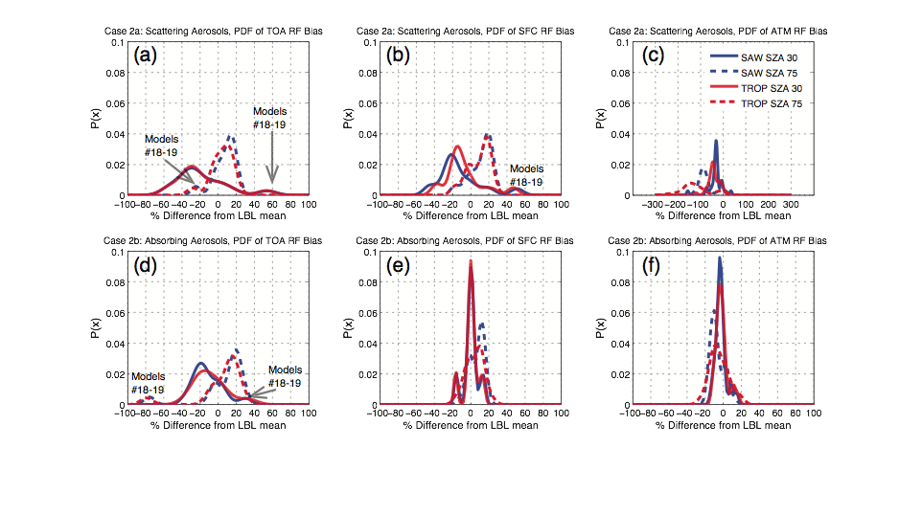
PDFs of Aerosol RF bias relative to benchmark LBL Results
Scattering Aerosols:
TOA RF
Scattering Aerosols:
Surface RF
Scattering Aerosols:
Atmospheric RF
Absorbing Aerosols:
TOA RF
Absorbing Aerosols:
Atmospheric RF
Absorbing Aerosols:
Surface RF
Strong dependence of bias (and diversity!) on sun elevation.
Bias decreases as:
Sun elevation decreases (SZA increases)
Aerosol absorption increases
Treatment of multiple-scattering leads to increased inter-model diversity.
Biases at specific SZA may be important for regional aerosol forcing and climate impacts.

Slide 14

AeroCom Current and Future Activities
Companion AeroCom papers:
Aerosol Direct Effect in15 Global models run in standard configuration:
Myhre et al., Radiative forcing of the direct aerosol effect from AeroCom Phase II simulations, submitted to ACPD, 2012.
Prescribed aerosol properties the same as in this study, but in global models with varying surface albedos, gaseous absorbers, and including clouds:
Stier, P. et al., Host model Uncertainties in Aerosol Forcing Estimates: REsults from the AeroCom Prescribed Intercomparison Study, submitted to ACPD, 2012.
Data hosting via the AeroCom web server:
http://aerocom.met.no/data.html
Future efforts will be made to include additional models, particularly those that have participated in the aforementioned studies, such that we will be better able to assess the full impact of differences in radiative transfer schemes on global model estimates of aerosol direct radiative forcing.
11th AeroCom Workshop 10-13 Sept, U. Washington, Seattle

Slide 15
Spare Slides

Slide 16
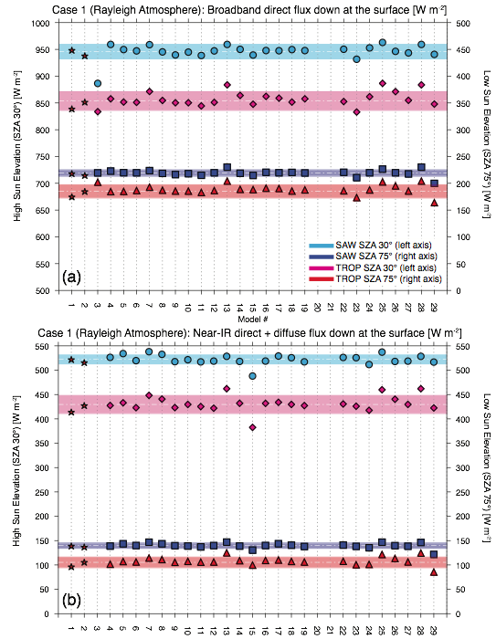
Results: Rayleigh Atmosphere (Case 1)
Fig 1a: Model diversity and bias relative to LBL for broadband direct downwards flux at surface <2% (standard deviation as % of mean; STDVM).
Fig 1b: Bias in total near-IR flux down to surface <2% except for TROP SZA 75º (6%). Diversity ranges 2-4%.
Largest bias in broadband diffuse flux down to surface (-3% at high sun elevation; 1-2% and low sun elevation).
With exception of diffuse fluxes, both inter-model diversity and bias relative to benchmark LBL codes increase with solar zenith angle (or, increase with decreased sun elevation) and with the amount of water vapor (higher for TROP). Thus, the highest errors and disagreement occur when the slant path of water vapor increases.

Slide 17
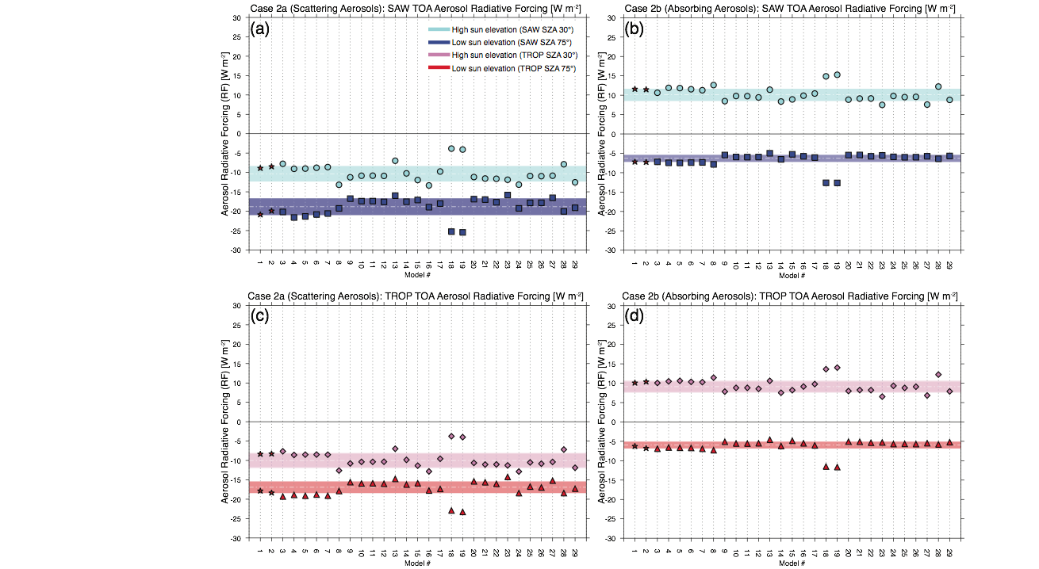
Results: Scattering Aerosol TOA Radiative Forcing (RF)
Average bias relative to LBL ~ -20% at SZA 30˚ (underestimate) and +10% at SZA 75˚ (overestimate).
Diversity is ~ 16% at SZA 30˚ and 9% at SZA 75˚.
Bias and diversity similar for surface forcing (not shown).
Multi-stream models (#3-8) generally in good agreement with LBL benchmark.
Aerosol RF more sensitive to sun elevation than to prescribed gaseous absorbers, as expected.
Models 19 & 20: Outliers due to lack of δ-rescaling; excluded from statistics.

Slide 18
Results: Absorbing Aerosol TOA Radiative Forcing (RF)
Models 19 & 20: Outliers due to lack of δ-rescaling; excluded from statistics.
Average bias relative to LBL ~ -11 to 14% at SZA 30˚ (underestimate) and +11 to 15% at SZA 75˚ (overestimate).
Diversity is ~ 13% at SZA 30˚ and 12% at SZA 75˚.
Bias in atmospheric forcing (not shown) < 6% and diversity < 10%.
Results indicate treatment of multiple-scattering is largest contributor to inter-model diversity for aerosol RF in this study.

