Slide 1
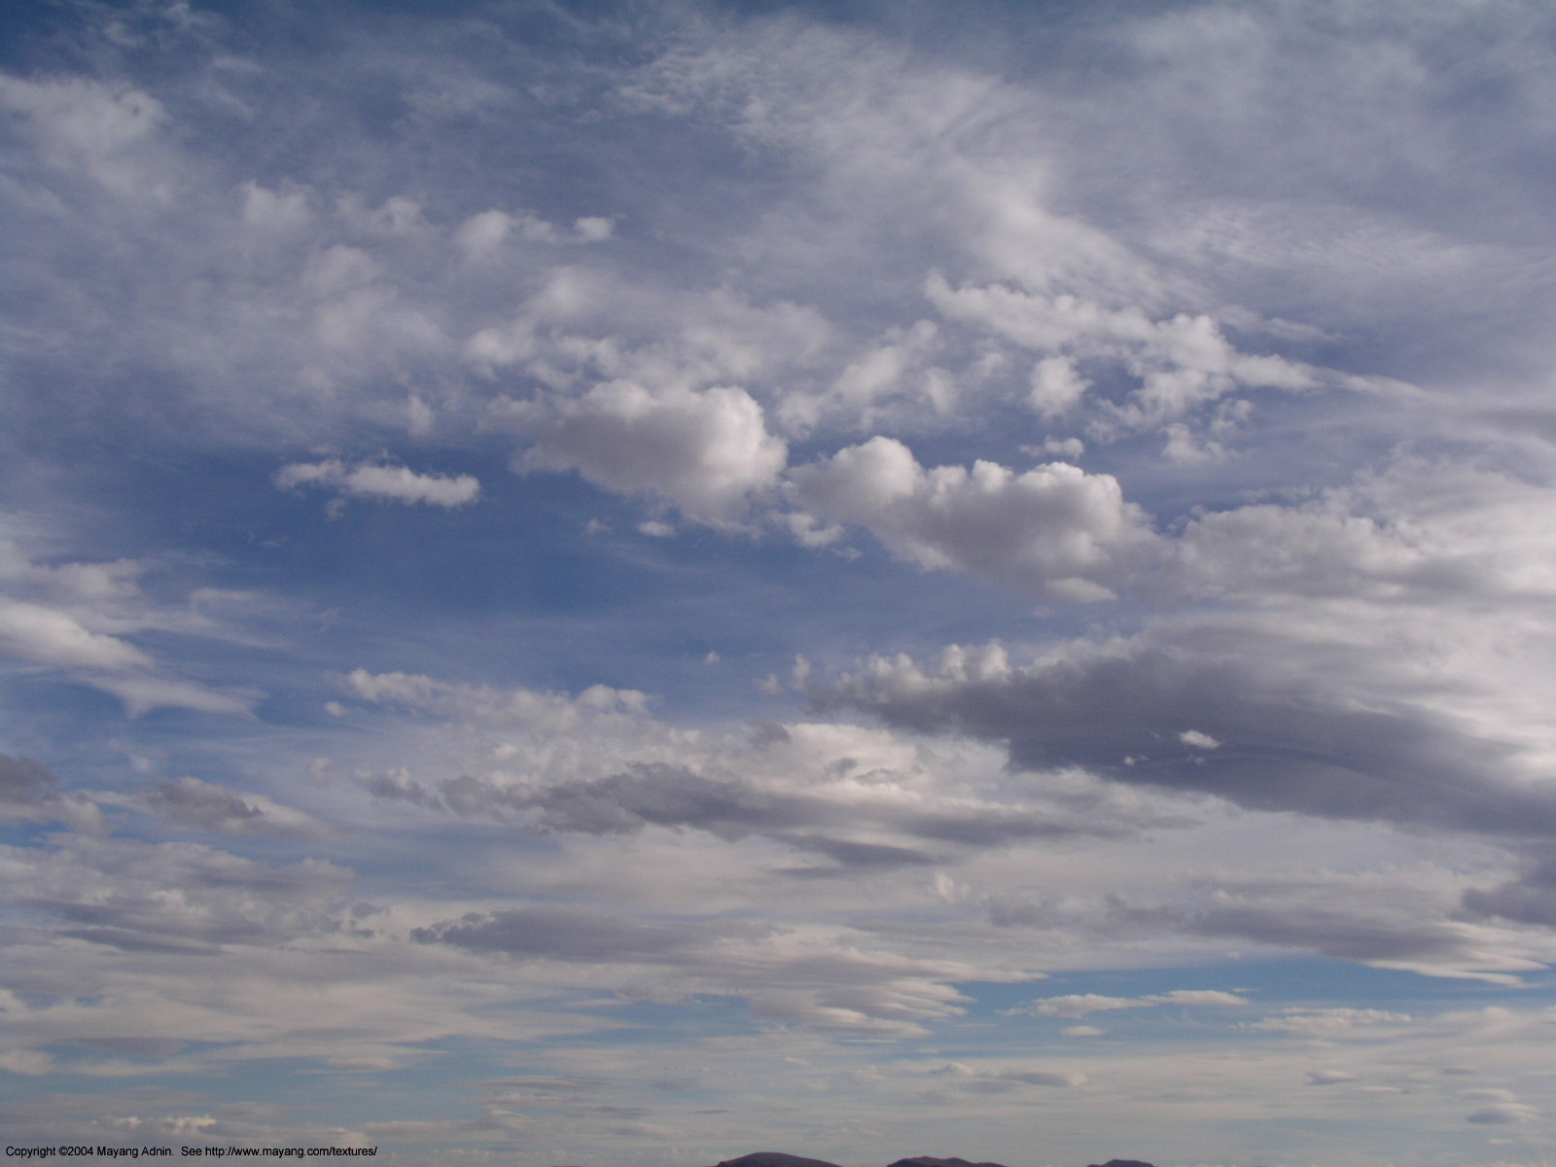
The Continual Intercomparison of Radiation Codes (CIRC)
Status report to IRC, July 2011
Lazaros Oreopoulos¹ and Eli Mlawer²
¹NASA-GSFC, Greenbelt, MD, USA (Chair)
²AER, Lexington, MA, USA (co-Chair)

Slide 2
What CIRC is about
RT model intercomparison intended to be the standard for documenting the performance of RT codes used in Large-Scale Models (LSMs)
Working group within IRC and GRP
Goal is to have RT codes of GCMs (incl. IPCC) report performance against CIRC
Phase 1 was launched on June 4, 2008
Phase “1a” was launched on January 19, 2010 (16 simpler variants of Phase I cases)
Website: http://circ.gsfc.nasa.gov
How CIRC differs from previous intercomparisons:
Observation-tested (LW) LBL calculations are used as radiative benchmarks
Benchmark results are publicly available
Observationally-based input (chiefly from an ARM product named BBHRP)
Intended to have flexible structure and be continual (i.e. updated periodically)

Slide 3
CIRC activities since last report and status
Submissions for Phase 1 sub-cases (“Phase 1a”) received
Technical paper on Phase I to be submitted to JGR-Atmos now in draft2; to be submitted in August.
CIRC now completely unfunded (neither co-chair has currently DOE-BER funding)
No CIRC presentation at last GRP meeting (1-day only due to pan-GEWEX)
Invitation to attend WGCM/WGNE meeting in October following letter of IRC to WGCM (Bony); CIRC will be represented

Slide 4
Longwave code participants
Model Index | Brief Model Description | In LSM? | Experiment variants | Submitted By | Reference(s)
0 | LBLRTM v.11.1/HITRAN 2004, MT_CKD_2.0, AER_V_2.0 | No | None | Delamere, Mlawer | Clough et al. (2005)
1 | RRTM-LW, 10-3000 cm⁻¹, CKD, 16 bands, 256 g-points | No | None | Iacono, Mlawer | Mlawer et al. (1997); Clough et al. (2005);
2 | RRTMG-LW, 10-3000 cm⁻¹, CKD, 16 bands, 140 g-points | Yes | None | Iacono | Mlawer et al. (1997); Iacono et al. (2008)
3 | CLIRAD-LW, 0-3000 cm⁻¹, k-distribution and one-parameter scaling, 10 bands, 85/113 k-points | Yes | “High/Low” accuracy | Oreopoulos | Chou et al. (2003)
4 | CCC 0-2500 cm⁻¹, CKD, 9 bands, 56 g-points | Yes | With/without scattering | Cole, Li | Li (2002); Li and Barker (2002); Li and Barker (2005);
5 | FLBLM, 40-3000 cm⁻¹, line-by-line, | No | With/without scattering | Fomin | Fomin (2006)
6 | FKDM, 40-3000 cm⁻¹, CKD, 23 g-points | No | None | Fomin | Fomin (2004)
7 | CAM 3.1, 0-2000 cm⁻¹, absorptiviy-emissivity approach | Yes | None | Oreopoulos | Collins et al. (2004)
8 | FLCKKR (LW), 0-2200 cm⁻¹, CKD, 12 bands, 67 g-points | No | None | Rose, Kratz, Kato, Charlock | Fu and Liou (1992); Fu et al. (1997)
9 | RRTMG-LW (as implemented in FMI ECHAM5.4), 10-3000 cm⁻¹, 16 bands, 140 g-points | Yes | None | Räisänen | Mlawer et al. (1997); Iacono et al. (2007)
10 | ES, 10-3000 cm⁻¹, 9 bands, ESF of band transmissions | Yes | With/without scattering | Manners | Edwards and Slingo (1996); Edwards (1996)
11 | GISS, 50-2000 cm⁻¹, CKD, 33 g-points | Yes | With/without scattering | Zhang, Rossow, Lacis | Zhang et al. (2004)

Slide 5
Shortwave code participants
Model Index | Brief Model Description | In LSM? | Experiment variants | Submitted By | Reference(s)
0 | CHARTS v.4.04/LBLRTM v.11.1/ HITRAN2004, line-by-line | No | None | Delamere, Mlawer | Moncet and Clough (1997); Clough et al. (2005)
1 | RRTM-SW, 0.2-12.2 µm, CKD, 14 bands, 224 g-points | No | None | Iacono, Mlawer | Clough et al. (2005)
2 | RRTMG-SW, 0.2-12.2 µm , CKD, 14 bands, 112 g-points | Yes | None | Iacono, Mlawer | Iacono et al. (2008)
3 | CLIRAD-SW, 0.175-10 µm, 11 bands, pseudo-monochromatic/k-distribution hybrid, 38 k-points | Yes | Two R_{sfc} averaging methods | Oreopoulos | Chou et al. (1998); Chou and Suarez (2002)
4 | CCC, 0.2-9.1 µm, CKD, 4 bands, 40 g-points | Yes | Three R_{sfc} averaging methods | Cole, Li | Li and Barker (2005); Li et al. (2005)
5 | FLBLM/ HITRAN 11v, 0.2-10 µm, line-by-line | No | None | Fomin | Fomin and Mazin (1998)
6 | FKDM, 0.2-10 µm, CKD, 15 g-points | No | Two treatments of cloud optical properties | Fomin | Fomin and Correa (2005)
7 | CAM 3.1, 0.2-5.0 µm, 19 spectral and pseudo-spectral intervals, | Yes | Two R_{sfc} averaging methods | Oreopoulos | Briegleb (1992); Collins (2001); Collins et al. (2004)
8 | FLCKKR (SW), 0.175-4.0 µm, CKD, 18 bands, 69 g-points | No | Two R_{sfc} averaging methods | Rose, Kratz, Kato, Charlock | Fu and Liou (1992)
9 | FMI/ECHAM5.4, 0.185-4 µm, 6 bands, Padé approximants to fit transmission functions | Yes | Two R_{sfc} averaging methods | Räisänen | Fouquart and Bonnel (1980); Cagnazzo et al. (2007)
10 | Edwards-Slingo 0.2-10 µm, 6 bands, ESF of band transmissions | Yes | Two R_{sfc} averaging methods | Manners | Edwards and Slingo (1996)
11 | NASA-GISS v. D, 0.2-5.0 µm, CKD, 15 g-points | Yes | Three R_{sfc} averaging methods | Zhang, Rossow, Lacis | Zhang et al. (2004)
12 | COART, 0.25-4.0 µm, 26 bands, k-distribution | No | None | Jin, Charlock | Jin et al. (2006)
13 | CLIRAD-SW modified, 0.2 -10 µm, 8 bands, k-distribution 15 k-points | No | Two R_{sfc} averaging methods | Oreopoulos | Tarasova and Fomin (2007)

Slide 6
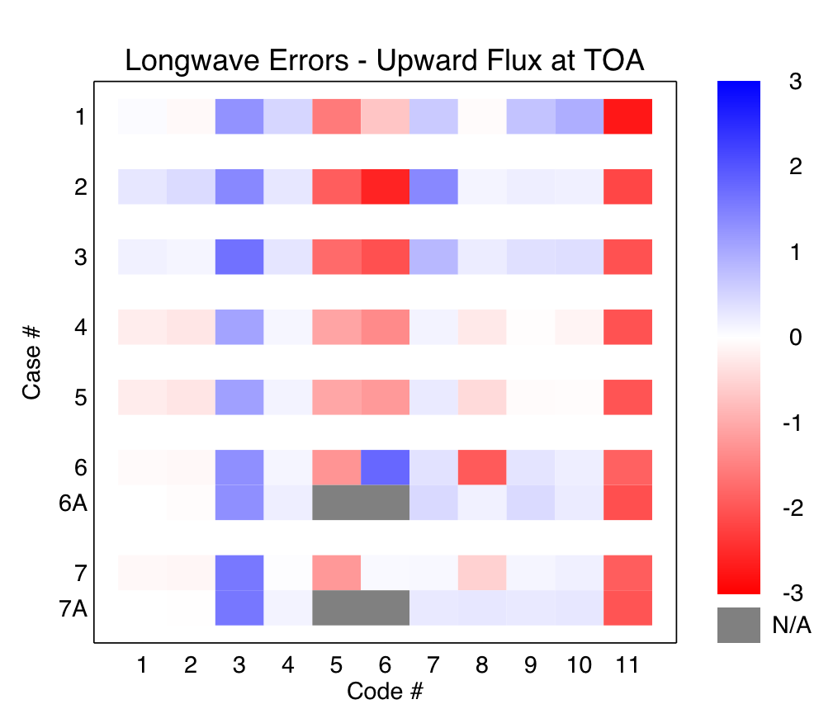
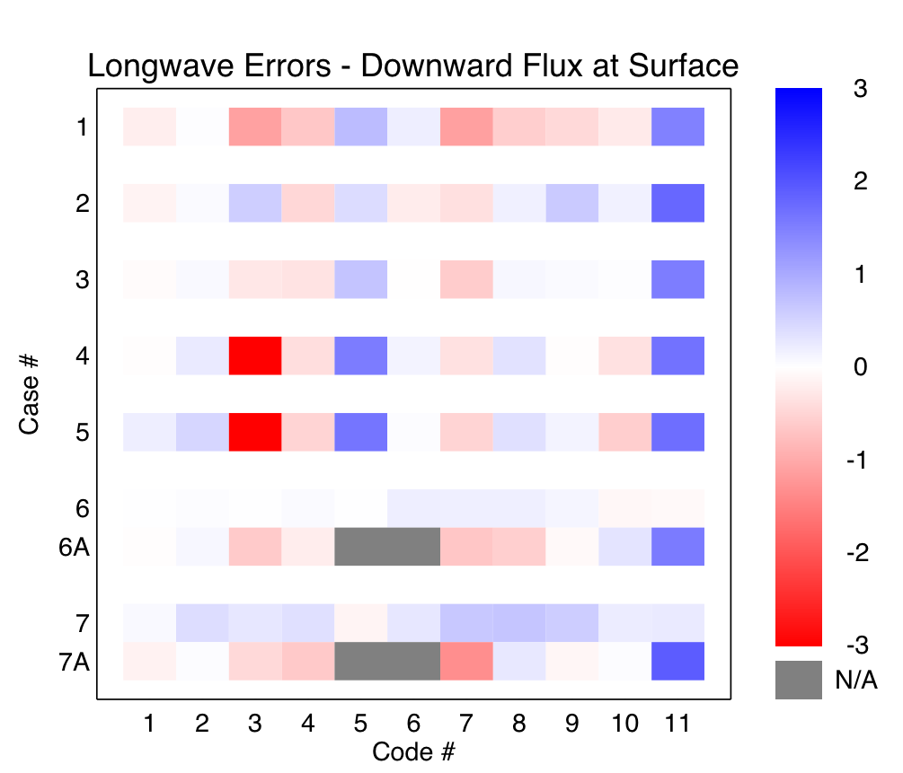
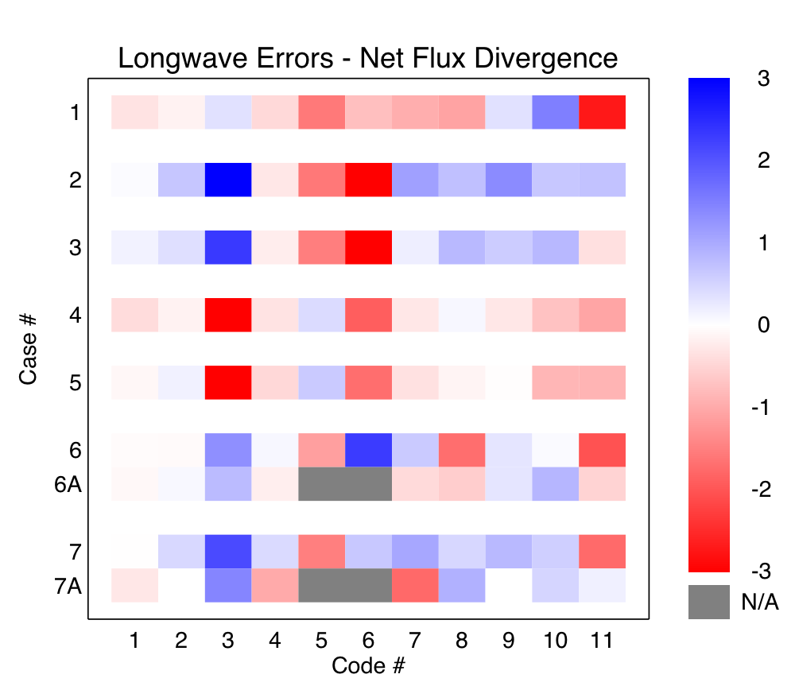
Longwave % errors (model-LBL)

Slide 7
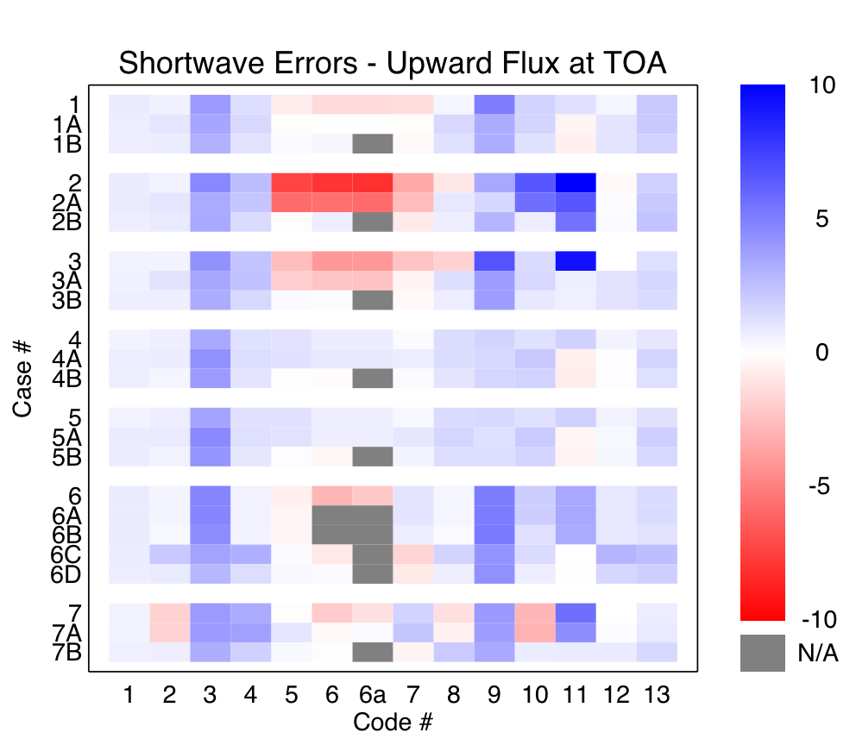
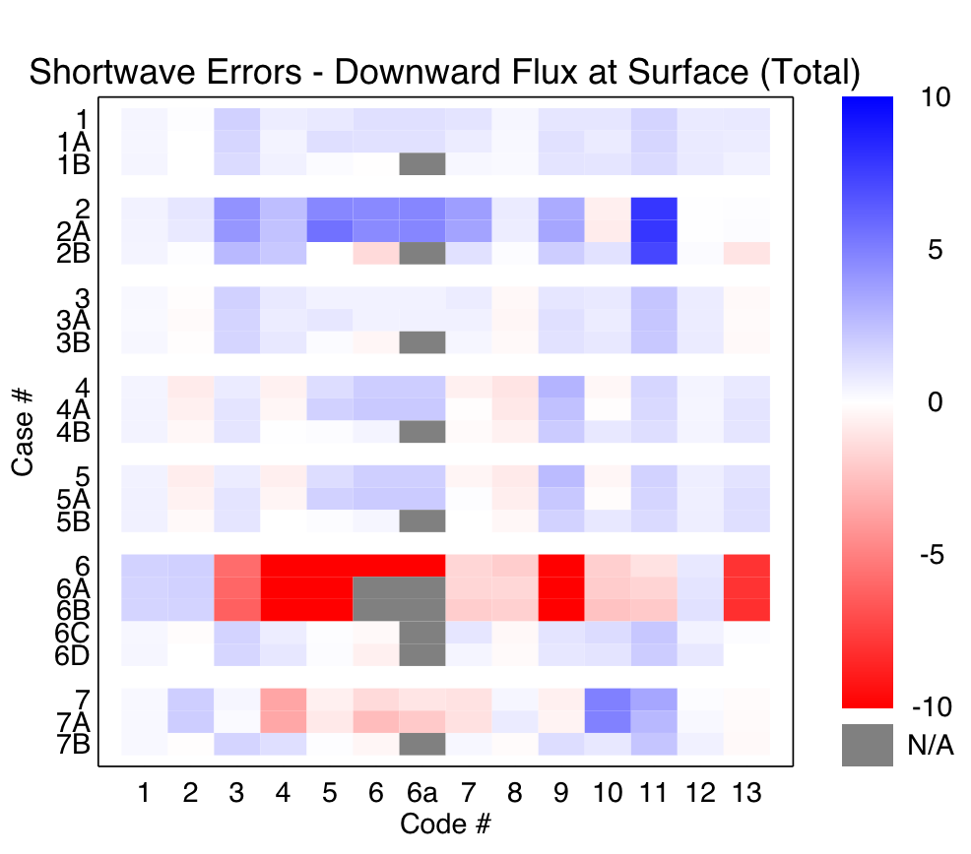
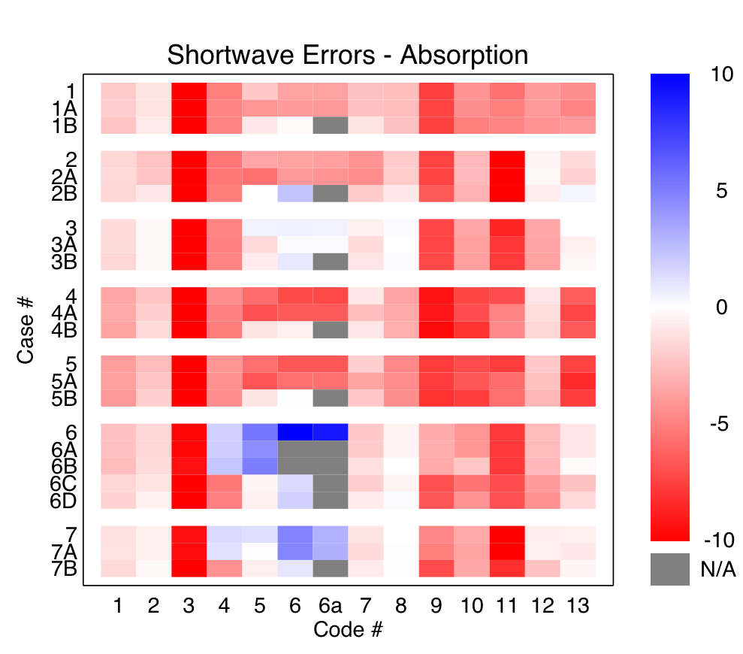
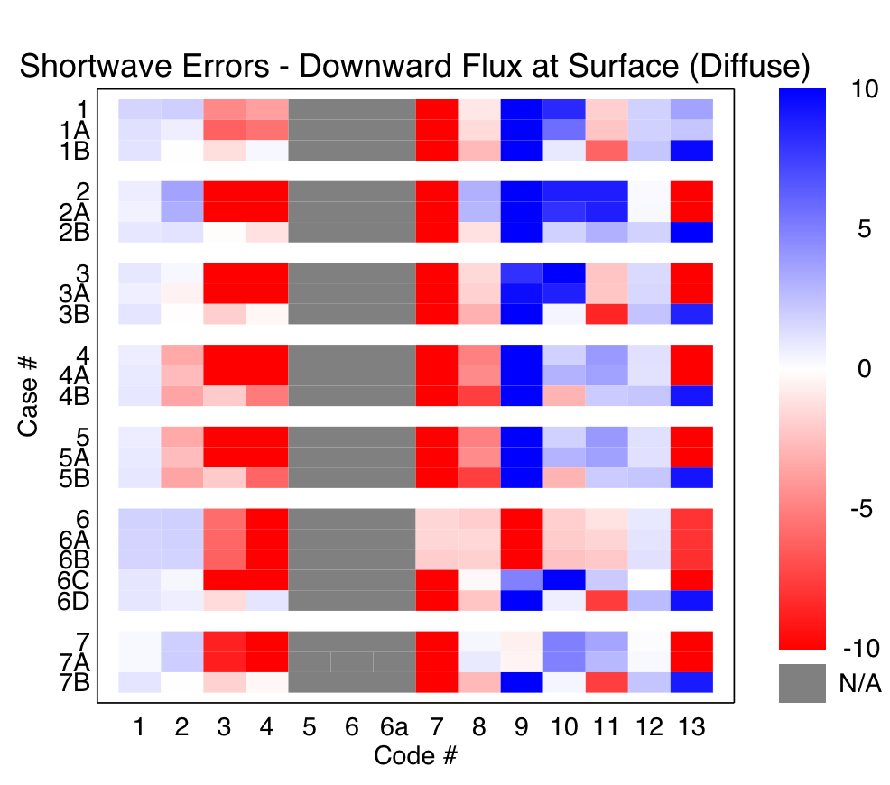
Shortwave % errors (model-LBL)

Slide 8
Overall performance

