Slide 1
Hyperspectral radiation: measurements and modelling
Proposal for a new IRC working group
Piet Stammes, KNMI, Netherlands
stammes@knmi.nl
IRC Business Meeting, Cape Town, 30 August 2017

Slide 2
Trend in satellite and ground-based measurements:
High-spectral resolution radiation measurements in contiguous spectral ranges for retrieval of atmospheric composition
Satellites - Solar range:
Contiguous: GOME, SCIAMACHY, OMI, GOME-2, …
Future: TROPOMI, GEMS, TEMPO, Sentinel-4, EMI, Sentinel-5, CLARREO, …
Specific bands: GOSAT, OCO-2, TanSat, …
Satellites - Thermal range:
Contiguous: AIRS, IASI, CrIS, …
Future: IRS, IASI-NG, …

Slide 3
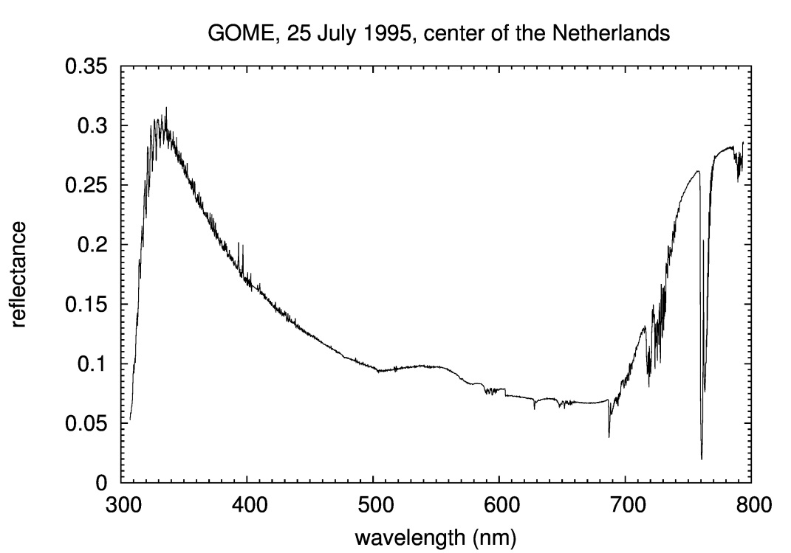
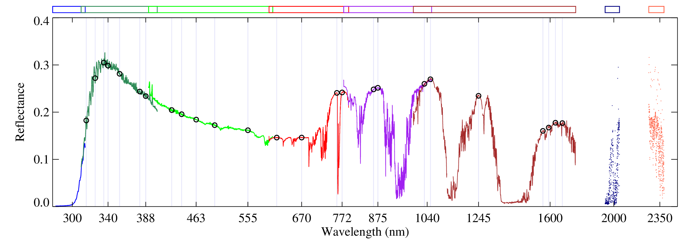
GOME & GOME-2, 1995 - current
4000 spectral points
Resolution: 0.2 – 0.5 nm
SCIAMACHY, 2002-2012
8000 spectral points
Tilstra et al., JGR, 2017)

Slide 4
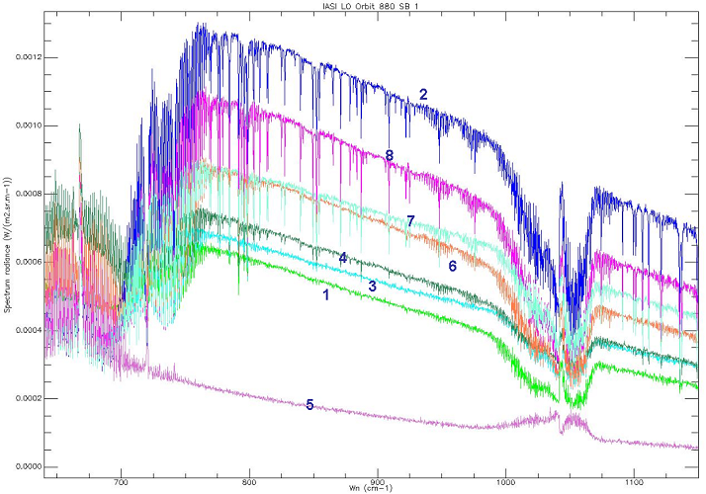
IASI
Spectral range: 650 – 2760 cm⁻¹
Spectral resolution: 0.35 – 0.50 cm⁻¹
8400 spectral points
From: CNES

Slide 5
Challenge and advantage
To interpret the spectra, we need to accurately and efficiently model the observed spectra.
Hyperspectral resolution spectra are the combination of all scattering, absorption and emission processes by atmosphere and surface:
  Trace gases
  Clouds
  Aerosols
  Surfaces
  These components and their changes are all visible from the same spectrum!

Slide 6
Topics for new working group on hyperspectral radiation
Measurements from satellite, ground, and aircraft
  Design
  Calibration
  Validation
  …
Modelling of the observations
  Importance of slit-function
  Inclusion of solar Fraunhofer lines
  Inclusion of Raman scattering
  Collision-induced absorption, line-mixing
  Differential retrieval methods (like DOAS method)
  Fast modelling of trace gas absorption bands (like O2 A-band)
  Coupling of scattering and absorption
  ….

Slide 7
Suggestions are welcome!
Members are invited! stammes@knmi.nl

