Slide 1
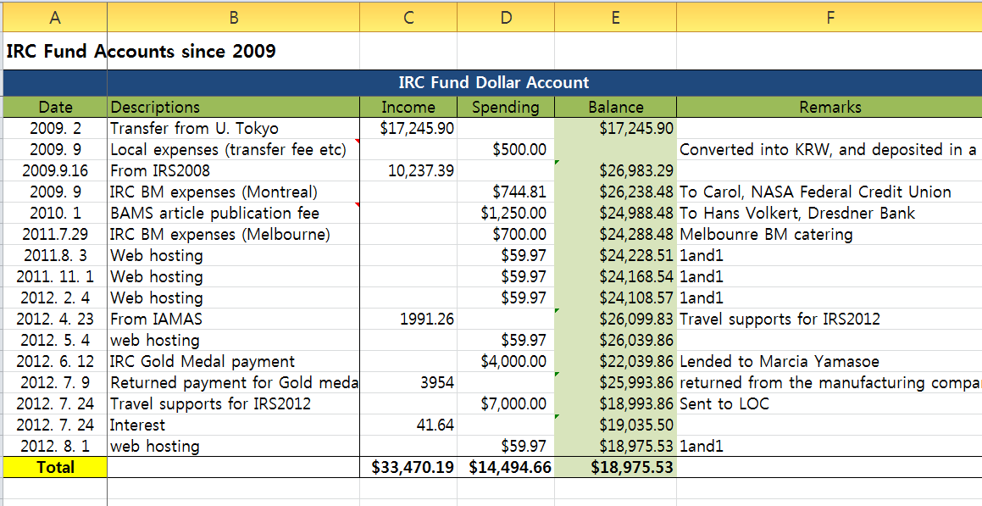
IRC fund balance (USD)

Slide 2
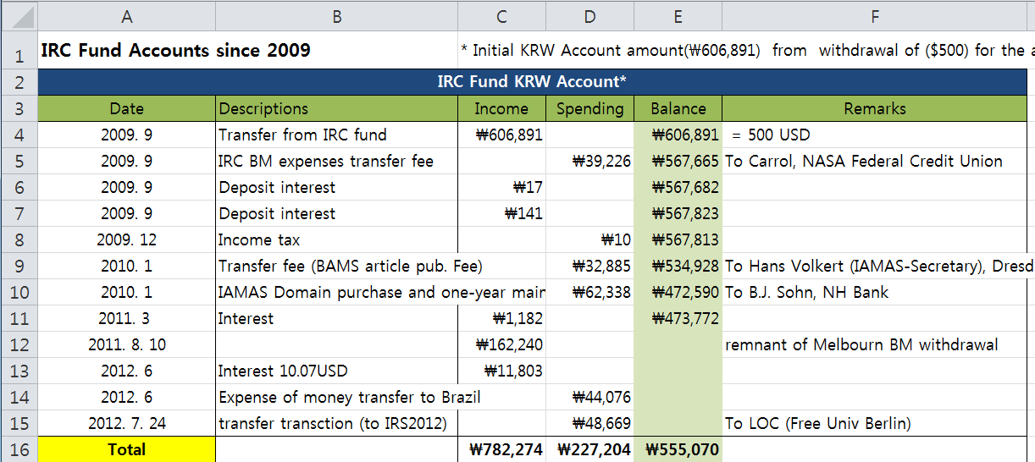
IRC fund balance (KRW)

